Slide 1
Multimodal Fake
News Detection
A comparison of text, image and fusion models on Fakeddit
Ali Abdulzahra
MSc Data Science
Professor Jialie Shen
September 2026

Slide 2
Aim and research questions
Does combining text and images improve classification over text alone?
Compare the modalities on the same posts
Test fusion gains and probability calibration
Examine leakage, selection bias and unseen sources
Fakeddit labels come from subreddit rules. They are not independently verified factual judgements.
02

Slide 3
Models and fusion methods
Component | Implementation
Text baseline | RoBERTa base, maximum 64 tokens
Image baseline | ResNet-50, 224 × 224 RGB images
Feature fusion | 768 text + 2,048 image features
Linear ablation | Text, image and concatenated probes
Late probability fusion | 0.45 × text + 0.55 × image
Ordinary fusion weights selected on validation data.
03

Slide 4
Dataset audit and image cleaning
Training posts removed during image cleaning
7,429
copies of one regional
placeholder image
All belonged to class 0
Training sample. Class 0 = fake/misleading. Class 1 = true-labelled content.
04

Slide 5
Evaluation design
Design | Training | Validation | Test
Cleaned development | 13,129 | 1,962 | 1,965
Ordinary final holdout | Fixed models | Fixed settings | 5,000
Source disjoint | 10,524 | 3,793 | 2,739
Source communities | 17 | 2 | 3
Source disjoint repartitions the cleaned development pool. Each experiment uses its own validation selection.
05

Slide 6
Demonstration of saved results
Recompute metrics from the recorded predictions
python tools/verify_saved_results.py
Check evidence fingerprints and case identifiers
Check fusion probabilities and the 0.50 threshold
Rebuild confusion matrices, accuracy and macro F1
Read-only demonstration. No training or model selection.
06

Slide 7
Validation-only fusion selection
p(fusion) = α × p(text) + (1 − α) × p(image)
Validation
Test
Join predictions by post ID
Check that labels agree
Search α from 0.00 to 1.00
Use the selected weight
Apply the same threshold
Record final predictions
Ordinary selection uses validation macro F1, a 0.05 grid and a fixed 0.50 classification threshold.
07

Slide 8
Development comparisons
Model | Development-test macro F1
RoBERTa | 0.8145
ResNet-50 | 0.7278
Initial feature-fusion MLP | 0.8157
Linear text / concatenated probes | 0.8097 / 0.8080
Late probability fusion | 0.8344
Development test: 1,965 posts. Tuned MLP validation results are a separate comparison.
08

Slide 9
Ordinary final holdout
Macro F1 on 5,000 posts
98
additional correct
predictions
McNemar p = 0.000138
Lower Brier score,
log loss and ECE
Macro F1 difference +0.0188. Paired 95% interval [0.0084, 0.0290].
09

Slide 10
Source-disjoint evaluation
Macro F1 on 2,739 posts
Text weight 0.00
Validation selected
image-only predictions
The ordinary fusion gain
did not transfer under
this source split
Fusion minus RoBERTa: −0.0825. Paired 95% interval [−0.1054, −0.0593].
10

Slide 11
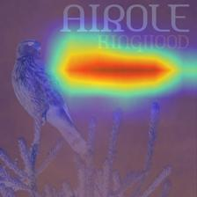
Explainability and error analysis
Attention on embedded text
The prediction is correct.
The heatmap suggests a possible
visual shortcut.
Selected case 3gvt03. Correct class-0 prediction. Explanations do not verify the truth of a post.
11

Slide 12
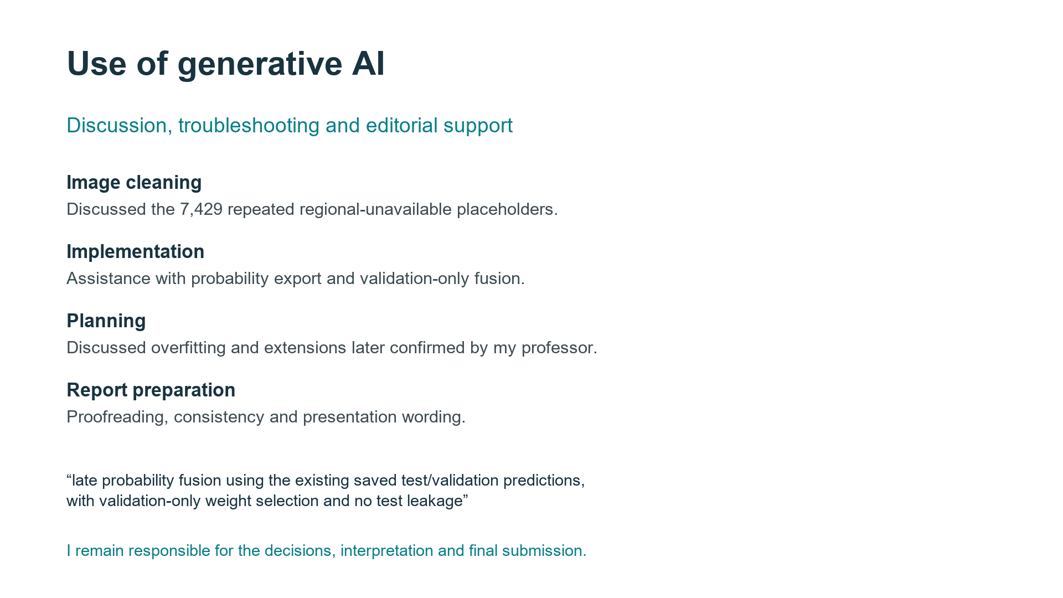

Slide 13
Evaluation limitations and future work
Few source communities in validation and test
Class-dependent image loss changes the evaluated sample
45 perceptual duplicate candidates still need review
Repeated source splits, seeds and chronological training
Confidence intervals condition on fixed checkpoints and sampled cases.
12

Slide 14
Conclusions
RoBERTa was the strongest single modality
Late fusion improved the ordinary holdout
The gain did not transfer to the source-disjoint test
The evaluation design changes what can be concluded about multimodal improvement.
13

